Slide 1
Sentiment Analysis On Twitter Data
Milana Mikhaeli
Alina Hlazkova
Notes:
Our theme is sentiment analysis on twitter data.

Slide 2

Sentiment analysis is the process of classifying whether a block of text is positive or negative.
Notes:
Sentiment analysis is the process of classifying whether a block of text is positive or negative. It is the interpretation and classification of emotions (positive, negative in our case) within text data using text analysis techniques. Sentiment analysis allows organizations to identify public sentiment towards certain words or topics.

Slide 3
Importing Dependencies
Pandas
Nltk
Sklearn
WorldCloud
Notes:
We use this libraris for our project:
Pandas, NLTK – we use for lemmatizing words
Slkearn, and Wordcloud that we use for representation the frequency of words in a text where the size of the word represents its frequency.

Slide 4
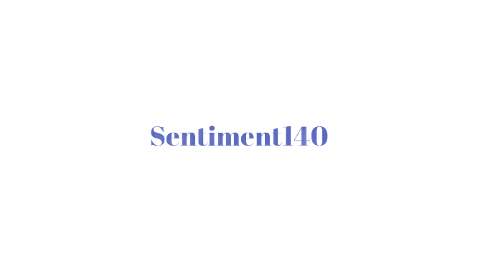

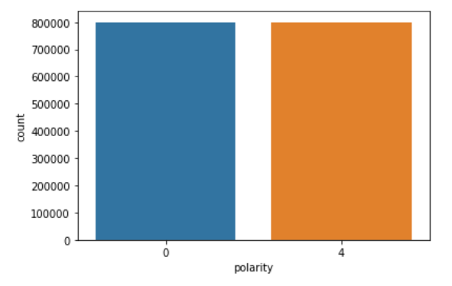
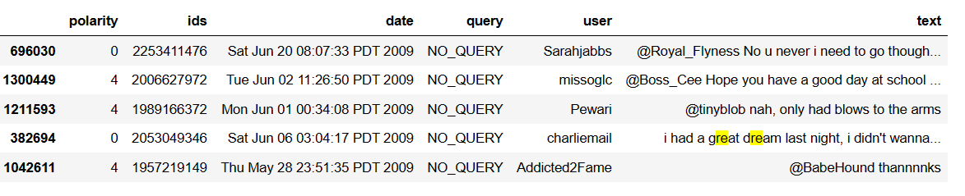
DATASET
Negative
Positive
Notes:
The dataset being used is the sentiment140 dataset. It contains 1,600,000 tweets extracted using the Twitter API. The tweets have been annotated (0 = Negative, 4 = Positive) and they can be used to detect sentiment(polarity in dataframe).
[The training data isn't perfectly categorised as it has been created by tagging the text according to the emoji present. So, any model built using this dataset may have lower than expected accuracy, since the dataset isn't perfectly categorised.]
It contains the following 6 fields:
We require only the sentiment and text fields, so we discard the rest.
Furthermore, we're changing the sentiment field so that it has new values to reflect the sentiment. (0 = Negative, 1 = Positive)

Slide 5
Preprocessing Text
Lower Casing:
Removing URLs
Replacing Emojis
Removing Usernames
Removing Non-Alphabets
Removing Consecutive letters
Removing Short Words:
Removing Stopwords
Lemmatizing
Notes:
For futher anlysis we should make text preprocessing. Text Preprocessing is traditionally an important step for Natural Language Processing (NLP) tasks. It transforms text into a more digestible form so that machine learning algorithms can perform better.
The Preprocessing steps taken are:
Lower Casing: Each text is converted to lowercase.
Removing URLs: Links starting with "http" or "https" or "www" are removed
Replacing Emojis: Replace emojis by using a pre-defined dictionary containing emojis along with their meaning.
Removing Usernames
Removing Non-Alphabets: Replacing characters except Digits and Alphabets with a space.
Removing Consecutive letters: 3 or more consecutive letters are replaced by 2 letters. ///если зададут вопрос(eg: "Heyyyy" to "Heyy")
Removing Short Words: Words with length less than 2 are removed.
Removing Stopwords: Stopwords are the English words which does not add much meaning to a sentence. They can safely be ignored without sacrificing the meaning of the sentence. (eg: "the", "he", "have")
Lemmatizing: Lemmatization is the process of converting a word to its base form. (e.g: “Great” to “Good”)

Slide 6
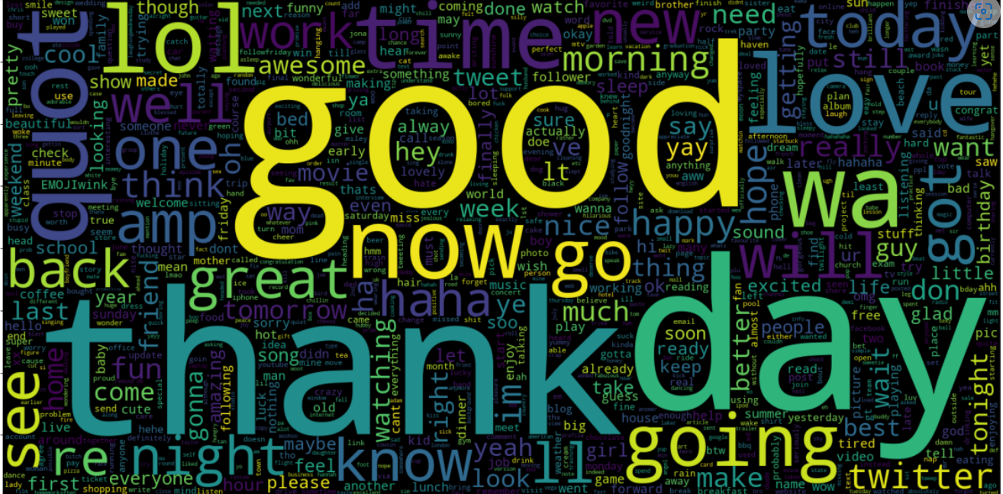
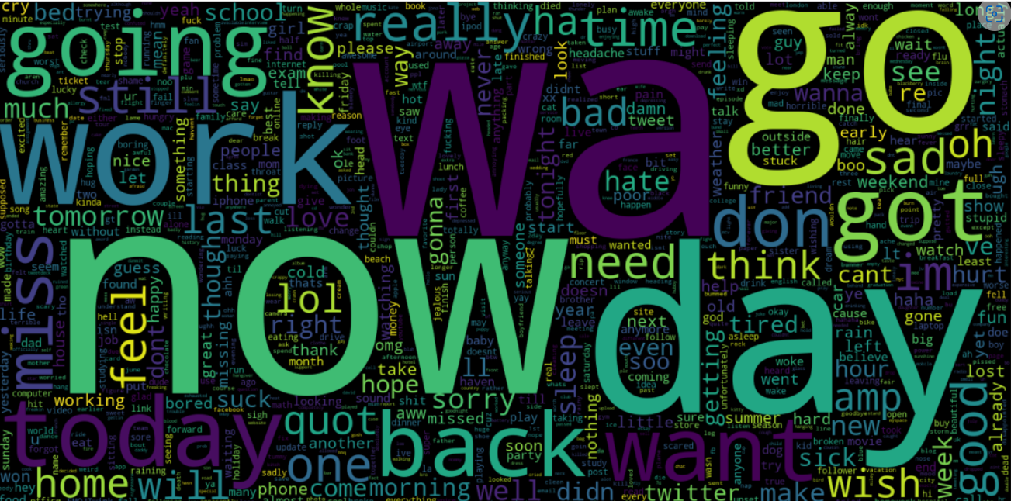
Analyzing data
Notes:
Now we're going to analyse the preprocessed data to get an understanding of it. We'll plot Word Clouds for Positive and Negative tweets from our dataset and see which words occur the most. So we can see that for positive tweets is the words as good, thank, lol, love. And for negative tweets it is now, work, going, go, need, think.

Slide 7
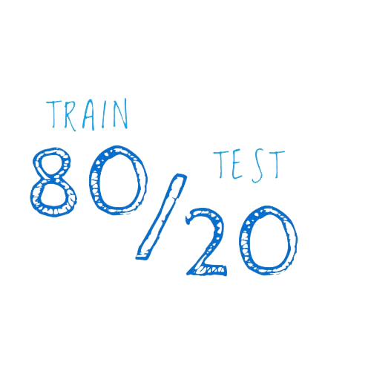
Splitting data
Notes:
After this we will Splitting the Data
The Preprocessed Data is divided into 2 sets of data:
Training Data: The dataset upon which the model would be trained on. Contains 80% data.
Test Data: The dataset upon which the model would be tested against. Contains 20% data.

Slide 8
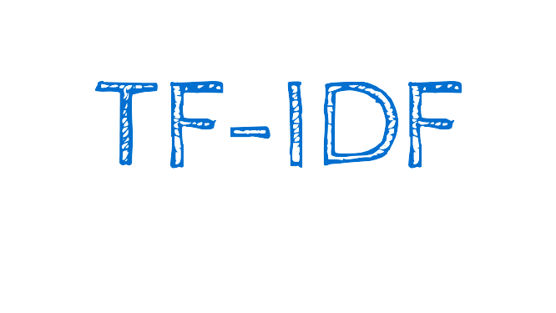
Notes:
TF-IDF indicates what the importance of the word is in order to understand the document or dataset. TF is a measure of how often a phrase appears in a document, and IDF is about how important that phrase is. The multiplication of these two scores makes up a TF-IDF score. TF-IDF is scored between 0 and 1. The higher the numerical weight value, the rarer the term. The smaller the weight, the more common the term. For tf idf vectorizer we use the library TfidfVectorizer form sklearn.
TF-IDF Vectoriser converts a collection of raw documents to a matrix of TF-IDF features. The Vectoriser is usually trained on only the X_train dataset.
The next step: Transforming the X_train and X_test dataset into matrix of TF-IDF Features by using the TF-IDF Vectoriser. This datasets will be used to train the model and test against it.

Slide 9
Creating and Evaluating Models
Bernoulli Naive Bayes (BernoulliNB)
Linear Support Vector Classification (LinearSVC)
Logistic Regression (LR)
Notes:
We use this models:
Bernoulli Naive Bayes (BernoulliNB)
Linear Support Vector Classification (LinearSVC)
Logistic Regression (LR)
Since our dataset is not skewed, i.e. it has equal number of Positive and Negative Predictions. We're choosing Accuracy as our evaluation metric. Furthermore, we're plotting the Confusion Matrix to get an understanding of how our model is performing on both classification types.

Slide 10
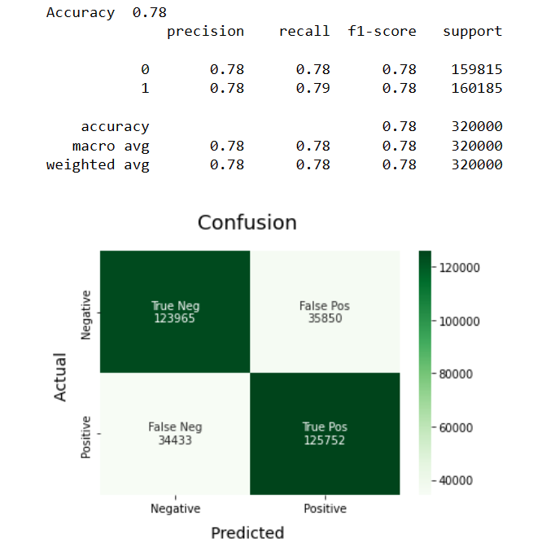
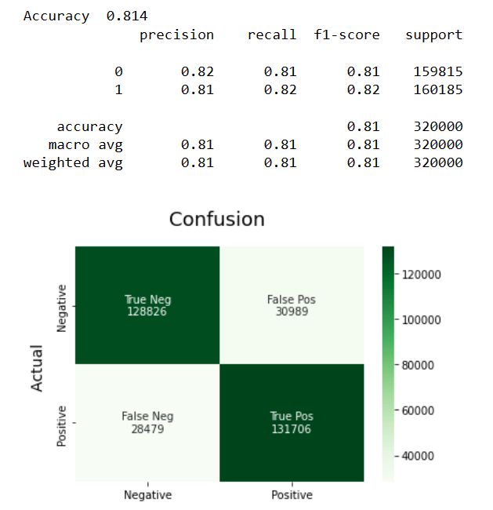
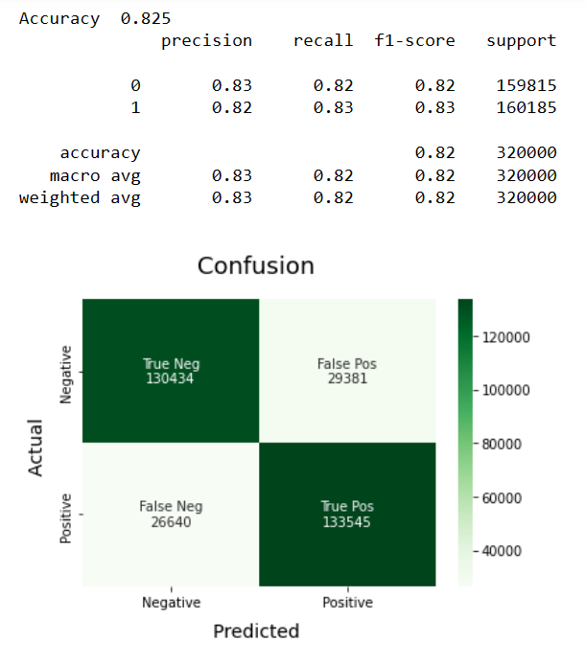
LinearSVC Model
Bernoulli Naive Bayes (BernoulliNB)
LRModel
Notes:
We can clearly see that the Logistic Regression Model performs the best out of all the different models that we tried. It achieves nearly 83% accuracy while classifying the sentiment of a tweet.
НЕ ЧИТАТЬ Пока не спросят
Precision (also called positive predictive value) is the fraction of relevant instances among the retrieved instances, while recall (also known as sensitivity) is the fraction of relevant instances that were retrieved.

Slide 11
References
1. http://help.sentiment140.com/for-students/
2. https://journalofbigdata.springeropen.com/articles/10.1186/s40537-015-0015-2
3. TF-IDF: An Explanation & Example | Onely
4. sklearn.feature_extraction.text.TfidfVectorizer — scikit-learn 1.2.0 documentation
5. stopwords/terrier.txt at master · igorbrigadir/stopwords · GitHub
6. Stop Words List in English for NLP – EnglishBix

